Slide 1
A Clinical Inspection of Heart Failure
Blake Wachter, MD, PhD
August 24, 2023

Slide 2
No Disclosures

Slide 3
Recognizing the Sick hf patient
Shortness of breath, worse with laying down
Edema (but not always in legs – may be in the belly – firm)
Grey color / ashen
Lethargic or confused somewhat
Cool to touch extremities (not hands and feet)
Decreased cap refill, cyanosis, mottling
Abdominal pain, decreased appetite
Labs: renal failure, severely elevated LFTs, elevated Tbili
Low blood pressure, high heart rate

Slide 4
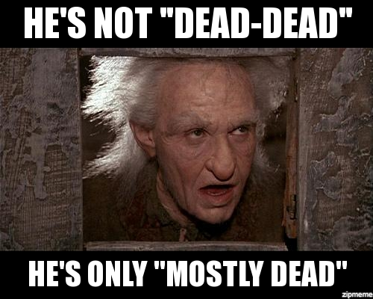

Slide 5
True love !

Slide 6
First thing, depuff
Diurese! Aggressively, at least 2 – 2.5 x the home amount in IV form.
No real difference in outcomes if pushes vs gtt (some respond better to one or the other)
Kidney function and LFTs should improve with good UOP (negative 1 to 10 liters off depending on patient)
Blood pressure should improve
HR should come down
Patient should dramatically feel better
WATCH POTASSIUM (keep around 4.0)
WATCH MAGNESIUM (keep above 2.0)

Slide 7
Second, don’t panic
Sometimes we need inotropic agents
Need PICC Line or central line
Ideally calculate a cardiac index by FICK (see Med Calculator)
Consider using inotropic agents if CI is < 2.0
Inotropic agents
Dobutamine 5mcg/kg/min usual dose, do not titrate, fast on, fast off
Milrinone 0.375 mcg/kg/min usual dose, 4-6 hours to see effect, slow off, can cause drop in BP so be ready for levophed or vasopressin in some cases
Long term (months) inotropic agents are not safe (i.e. patient don’t go home on these)
Both can cause arrhythmias

Slide 8
HELP Afib, Vtach, Tachycardia !
Remember: Don’t Panic
Afib, Some vtach, and tachycardia is expected in sick HF patients !
DO NOT USE multiple doses of betablockers to try to control – will cause to go into worse cardiogenic shock
DO NOT USE diltiazem gtt ! Causes cardiogenic shock
Instead put on amio gtt at 1mg/hr until further notice, no titration
Consider anticoagulation if afib

Slide 9
Wachter’s tricks
I won’t wean dobutamine until the patient is dry, when I am ready, I go slow – decrease by 1mcg/kg/min per day
Same with milrinone
Keep K and Mag always in range
I don’t worry about the Cr initially, it should get better (if not, well then there are nephrologists that can dialyze!)
Don’t use betablocker with dobutamine (bc dobutamine is a beta agonist)
Start valsartan if able
Consider farxiga

Slide 10
Not every one can get advanced therapies
Advanced therapies: LVAD , Heart Transplant
Things we consider:
How sick, if inotropic dependant
Compliance
Social support
Psych
Financial situation (insurance)
No drugs, ETOH for at least 6 to 12 months (drug test confirmed)

